Slide 1

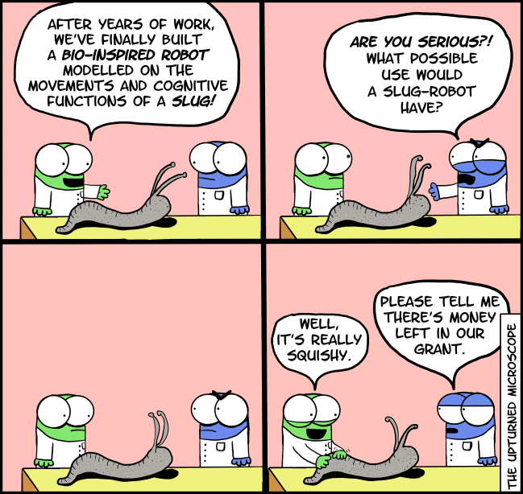
Nhat (Nick) Pham
Lecture 4: “On-chip Intelligence, Bio-inspired IoT, and Bio-sensing Wearables”
(the slides is partially adapted from Daniel Situnayake and Vikram Iyer’s presentations)
https://www.wired.com/story/amazon-warehouse-robots/

Slide 2
What are … hot?

Slide 3
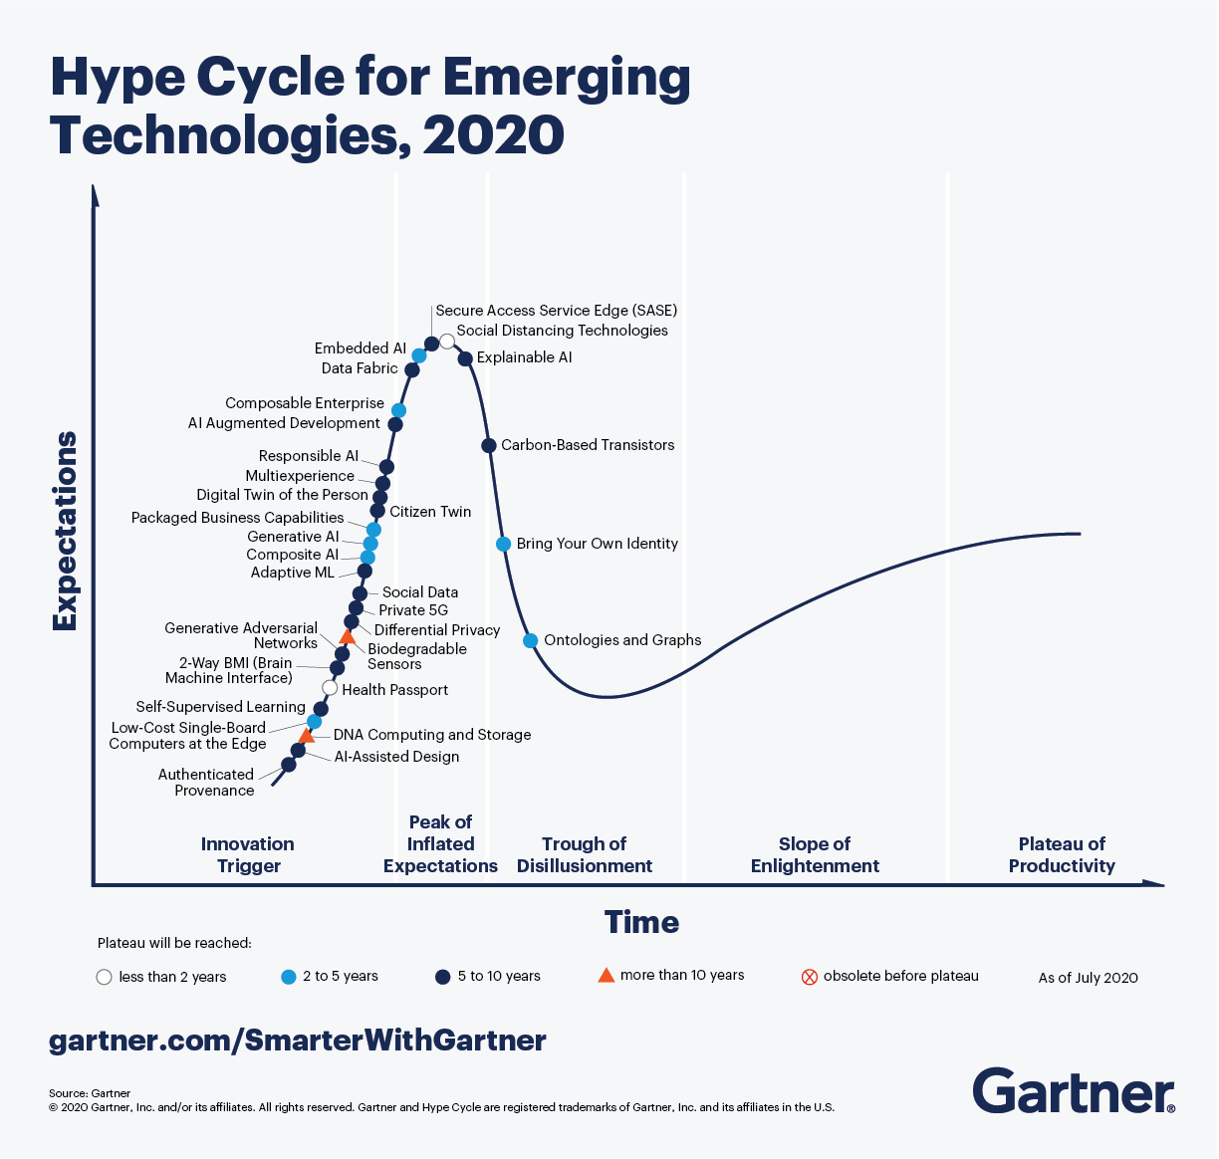

Slide 4
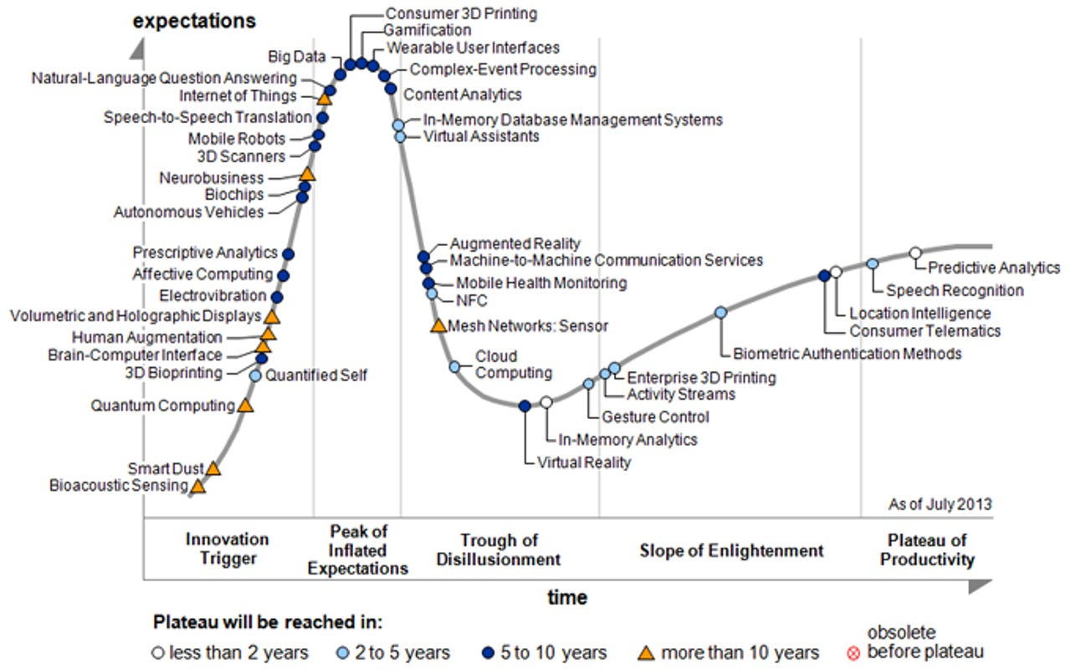
Gartner

Slide 5
(1) Tiny Machine Learning with TensorFlow Lite Microcontroller

Slide 6
TensorFlow Lite?
TensorFlow Lite is a production
ready, cross-platform framework for
deploying ML on mobile devices and
embedded systems

Slide 7
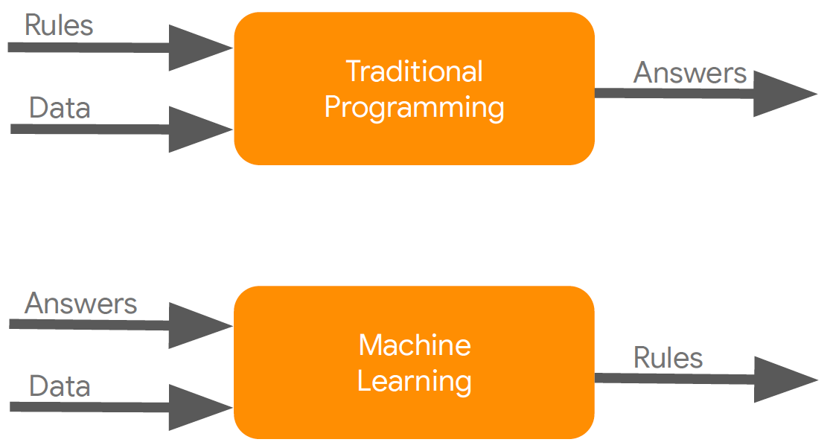
Basics of Machine Learning

Slide 8
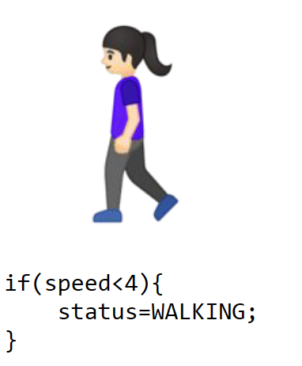
Basics of Machine Learning – Activity recognition

Slide 9
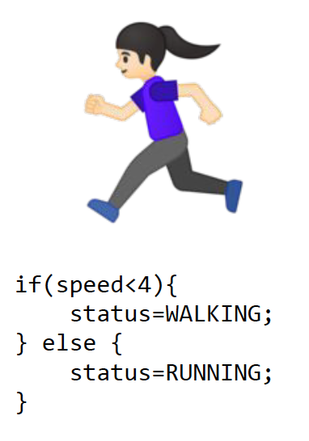
Basics of Machine Learning – Activity recognition

Slide 10
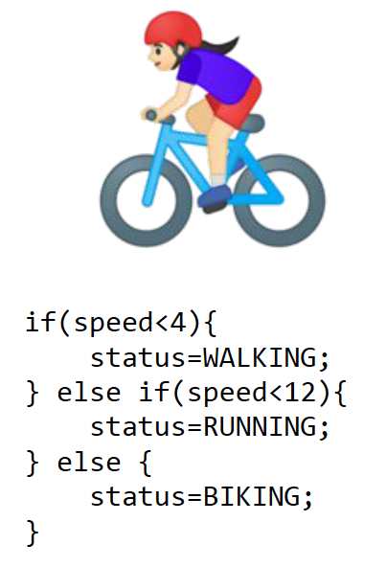
Basics of Machine Learning – Activity recognition

Slide 11
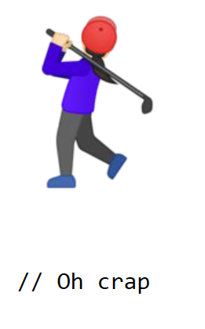
Basics of Machine Learning – Activity recognition

Slide 12
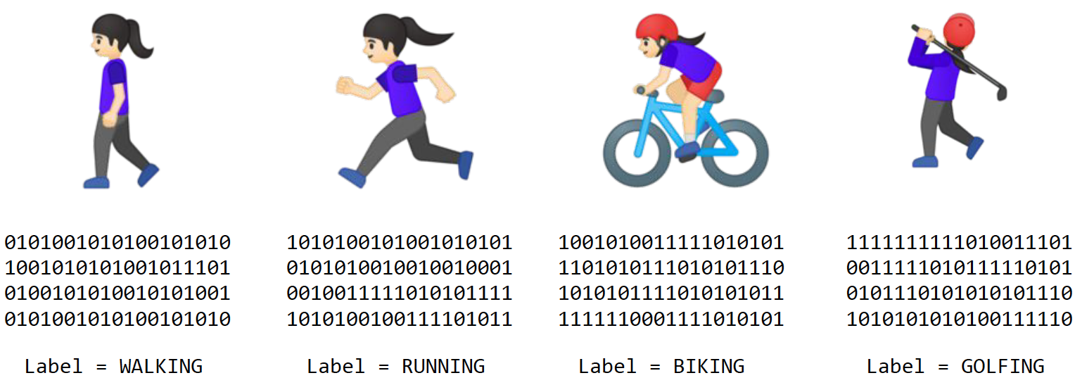
Basics of Machine Learning – Activity recognition

Slide 13

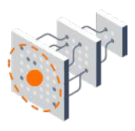
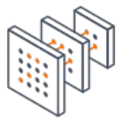

Basics of Machine Learning – Key terms
Dataset
Training
Model
Inference

Slide 14
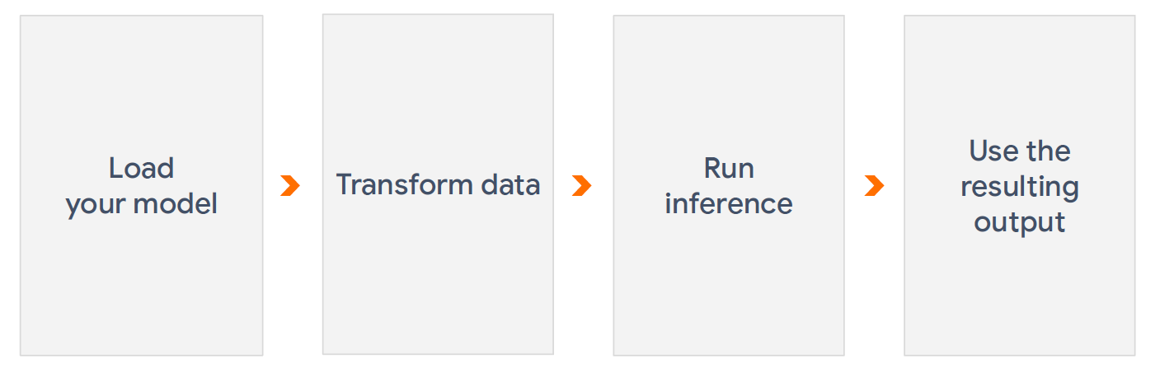
Basics of Machine Learning – Inference

Slide 15
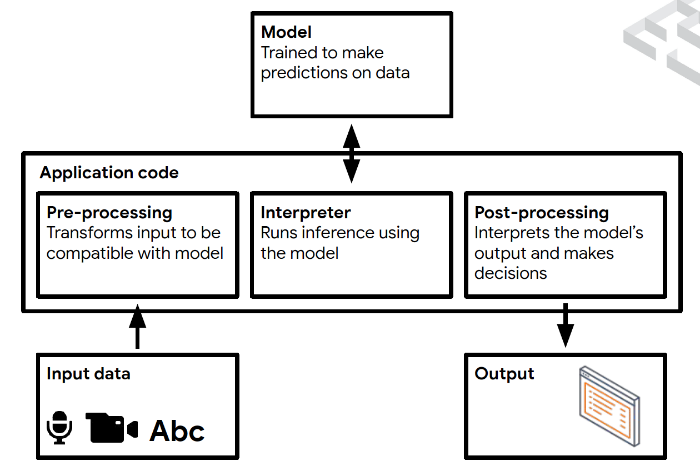
Basics of Machine Learning – TensorFlow Framework

Slide 16
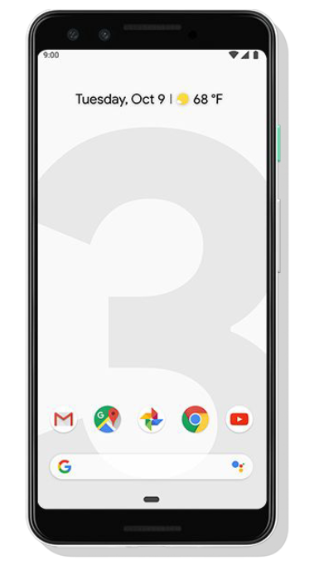
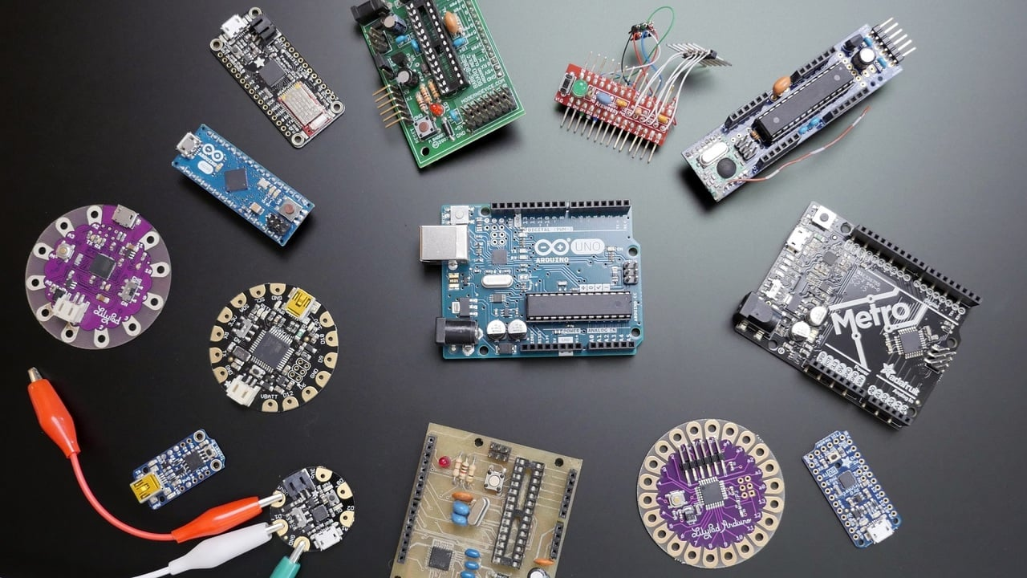
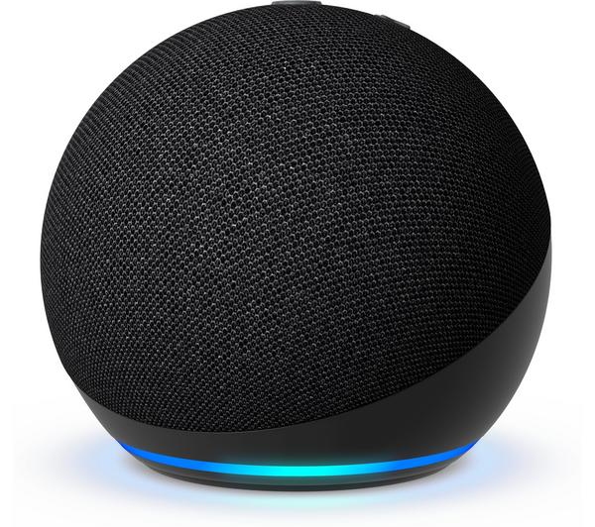
Edge ML Explosion
Lower latency & close knit interactions
Network connectivity
Privacy preserving

Slide 17
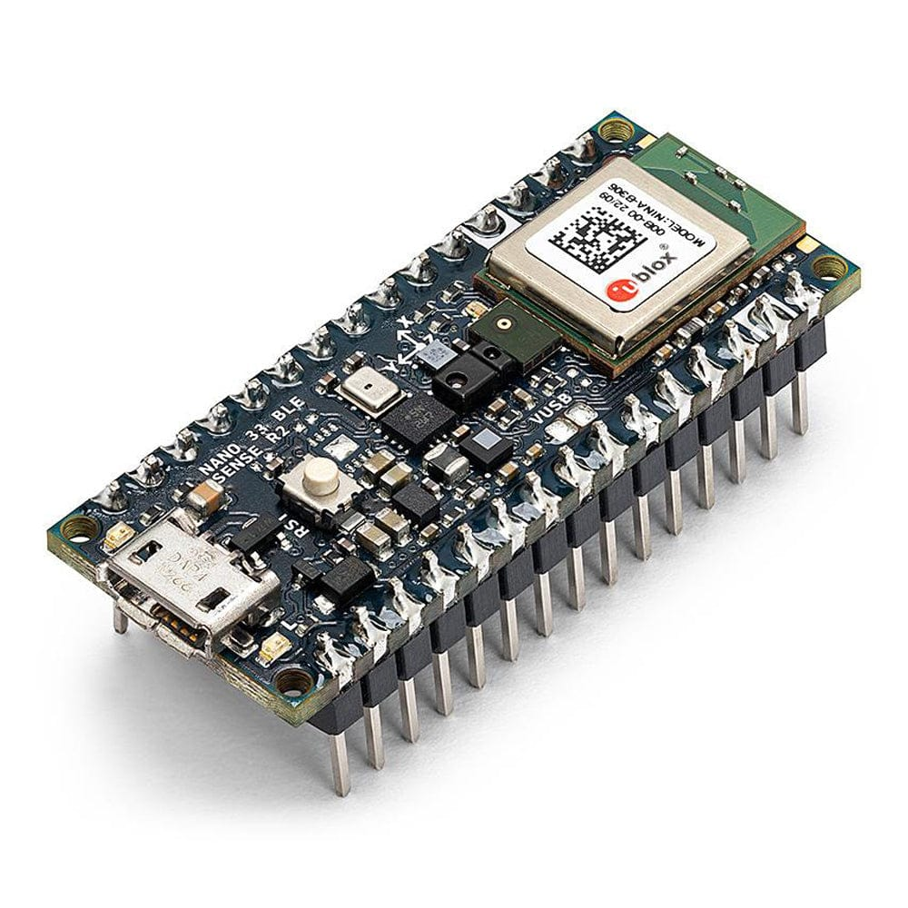
Edge ML Explosion - Challenges
Uses little compute power
Works on limited memory platforms
Consumes less battery
Arduino BLE Sense
nRF52840 (32-bit ARM® Cortex™-M4)
64MHz
256 KB SRAM, 1MB flash

Slide 18
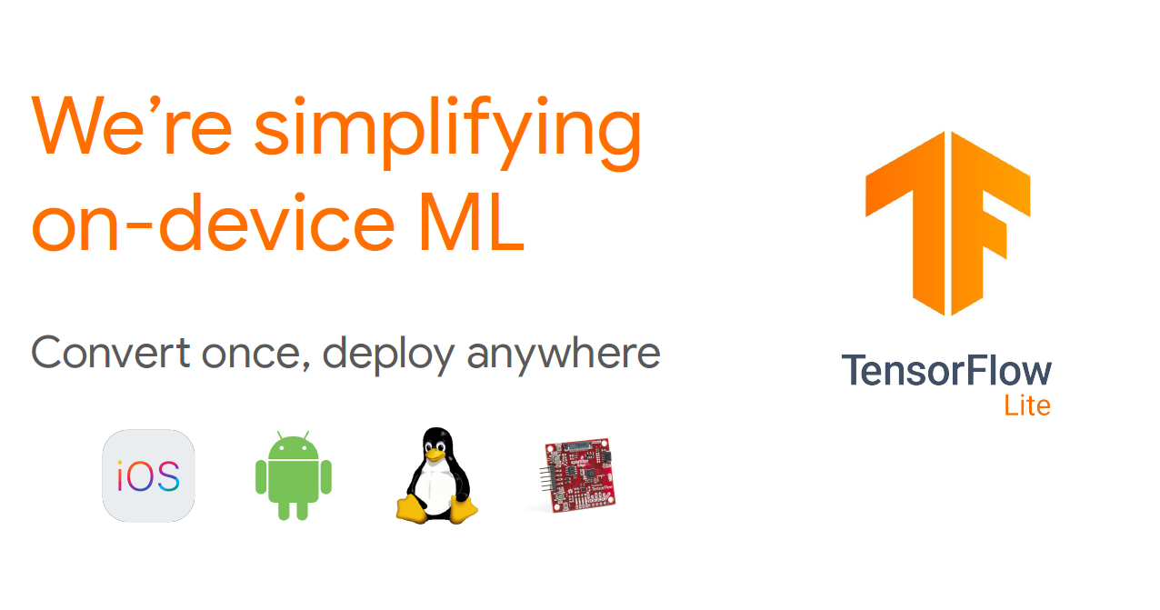
TensorFlow Lite

Slide 19
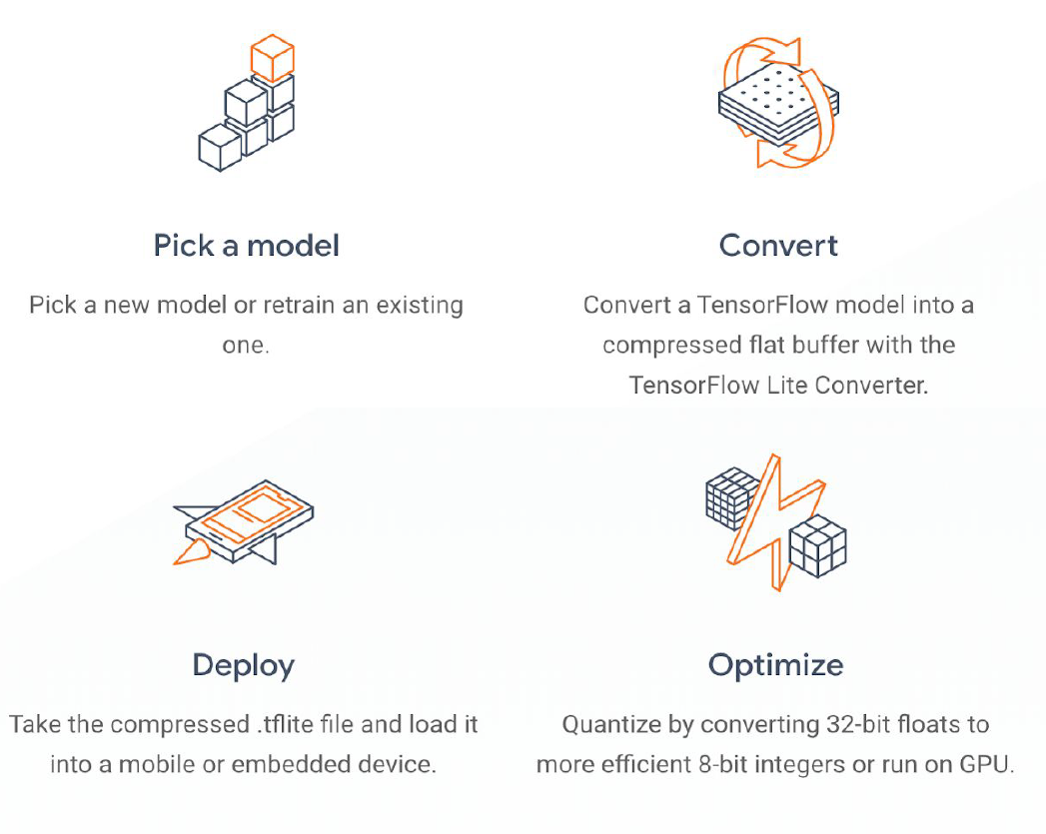
TensorFlow Lite

Slide 20
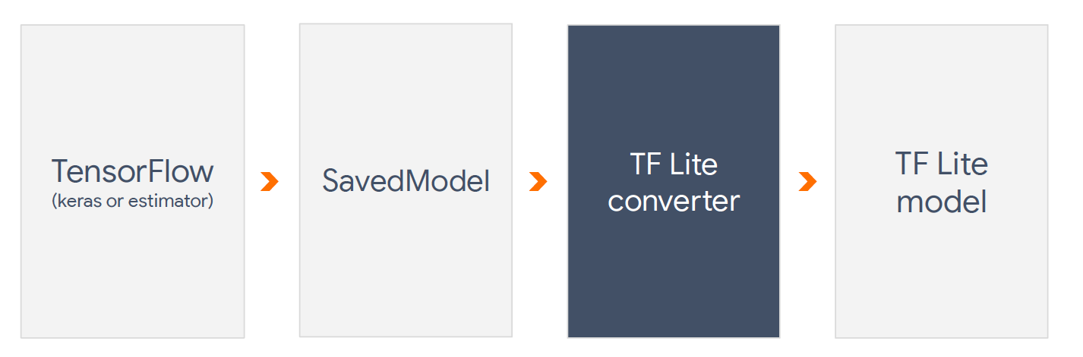
TensorFlow Lite – Converting

Slide 21
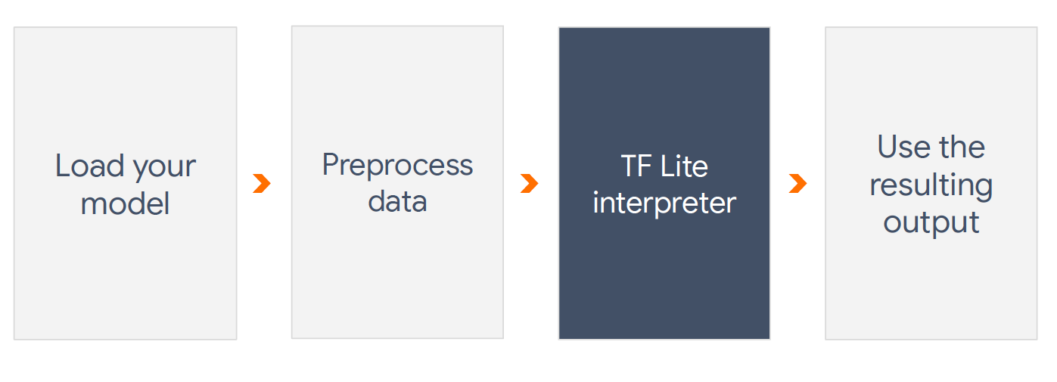
TensorFlow Lite – Running the models

Slide 22
Examples – Speech detection
Demo time

Slide 23
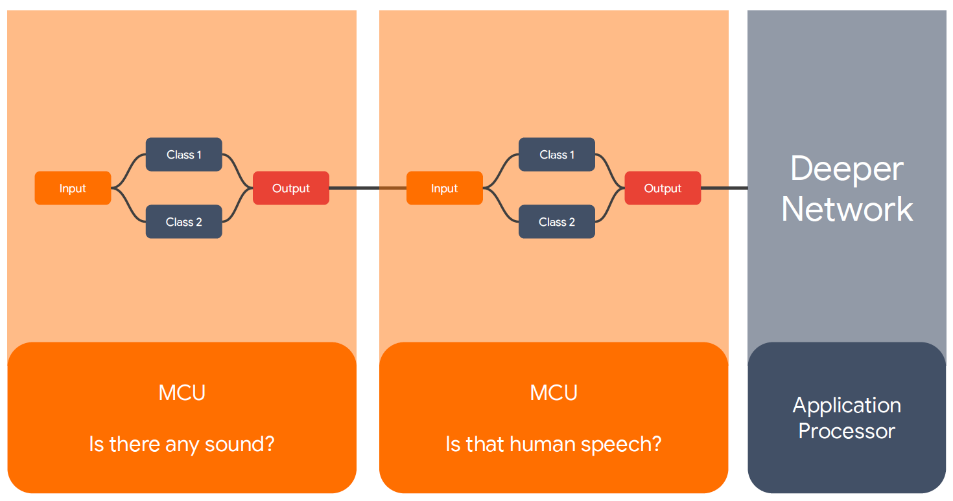
Examples – Speech detection

Slide 24
Key takeaways
TensorFlow Lite is a framework to help with resource-constrained embedded devices.
The model needs to be trained and optimized before converting.
Not all neural network operations are currently supported.
Here is the list of supported operations.
https://github.com/tensorflow/tflite-micro/blob/main/tensorflow/lite/micro/all_ops_resolver.cc

Slide 25
(2) Living IoT: A Flying Wireless Platform on Live Insects (ACM MobiCom’19)
Vikram Iyer, Rajalakshmi Nandakumar, Anran Wang, Sawyer Fuller, Shyam Gollakota
University of Washinton.

Slide 26
What if Internet of Things (IoT) devices could fly?

Slide 27
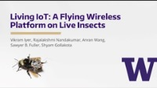

Slide 28
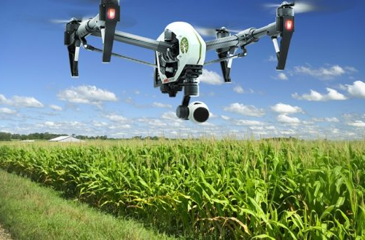
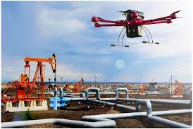
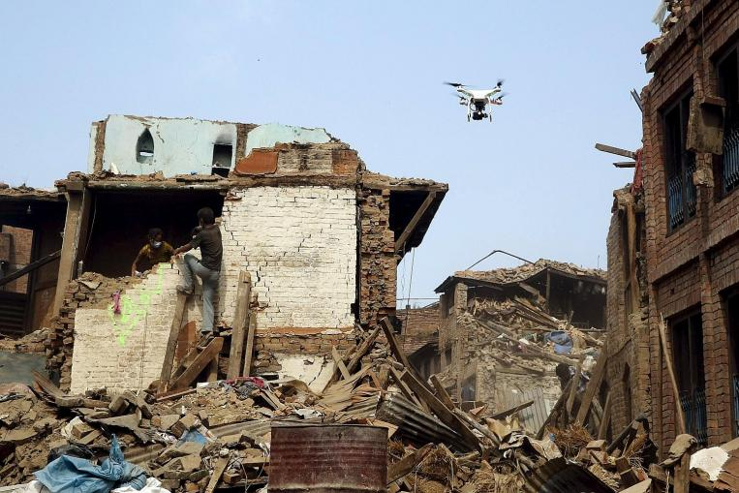
Drones as flying sensor platforms

Slide 29
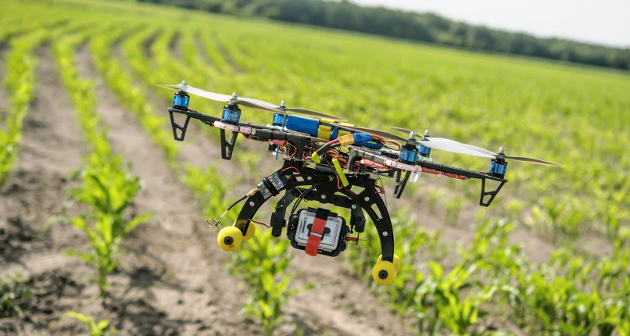
Drones consume lots of power
Need recharging every 10-20 min

Slide 30
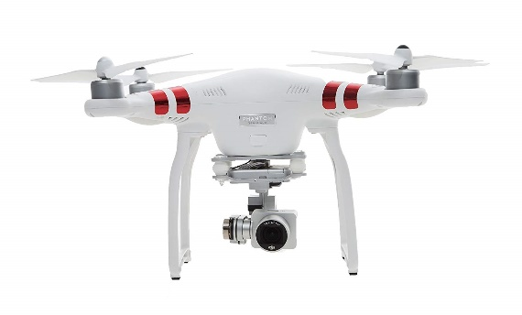
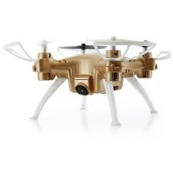
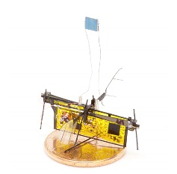
Drones consume lots of power
20
15
10
5
0
Battery life (min)
DJI Phantom 3
Skyeye-Nano
UW Robofly
0 10 20 30
Width (cm)
Fundamentally hard to get long battery life

Slide 31
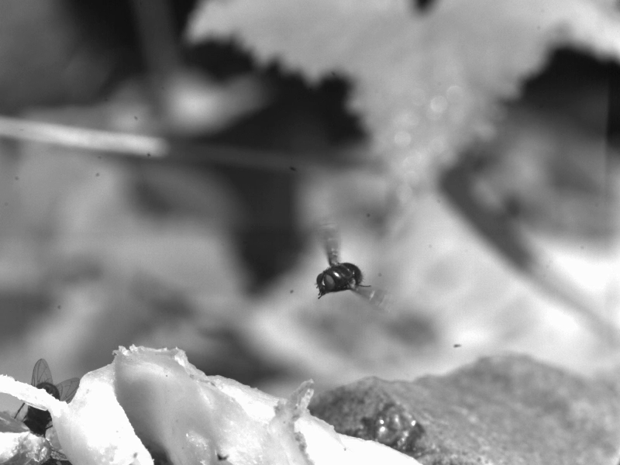
Look to nature for solutions

Slide 32
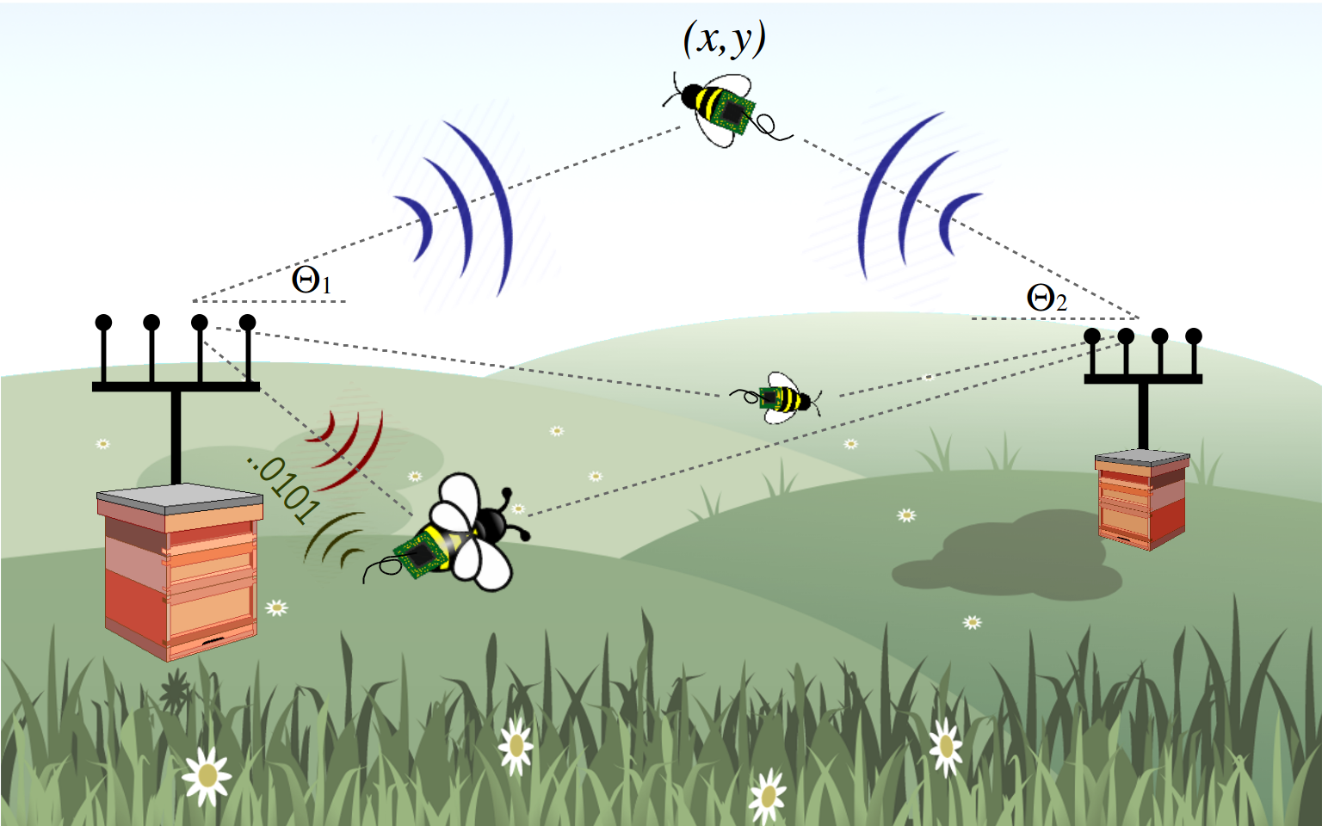
Idea: Use live insects to carry wireless sensors

Slide 33
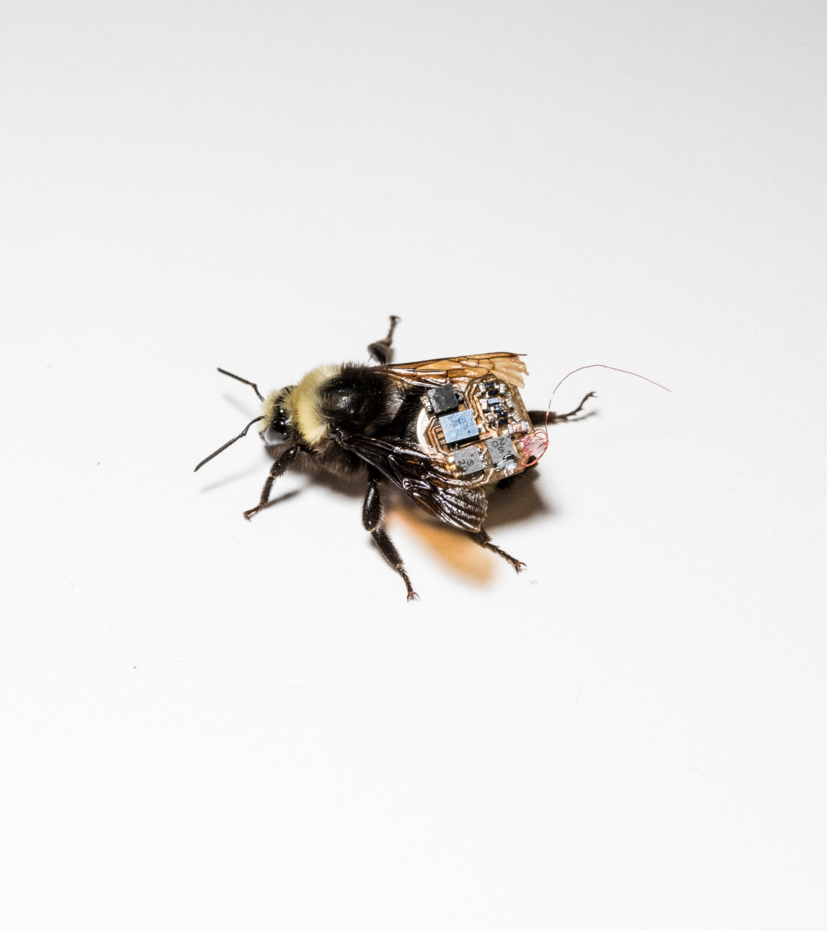
Bio-based solution
No need for mechanical propulsion
Bees are introduced on farms for pollination
Bees sense their environment

Slide 34

Live bumblebee carrying our sensors and electronics

Slide 35


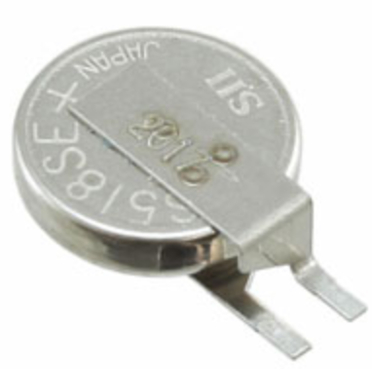
Challenge 1: Small weight and low power
Size/Weight
Power
~100 mg = 70 mg battery + 30 mg electronics

Slide 36
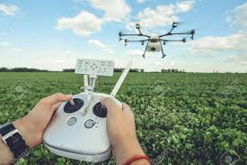
Challenge 2: Can’t control bee motion

Slide 37
Our Solutions
Building lightweight hardware
2D location tracking of bees

Slide 38
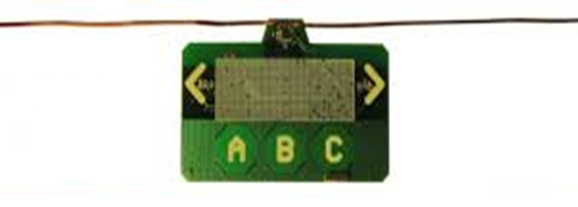
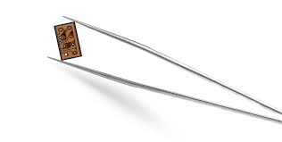
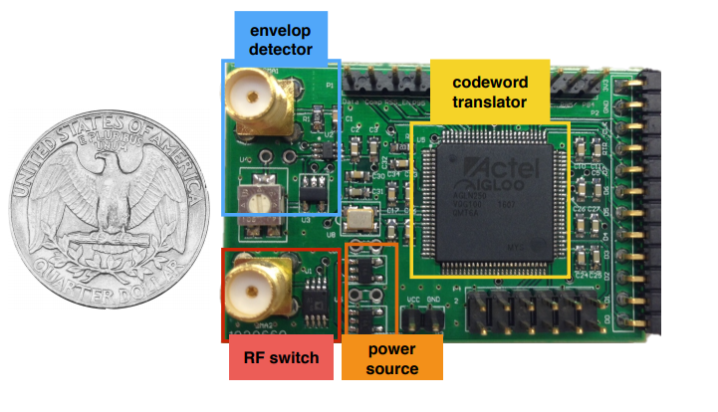
New problem: designing for small size and weight
Ambient backscatter
Custom ASIC
+ Lowest power and size
- Needs external components
- Long expensive process
- Not programmable
Freerider
Need light-weight programmable solution

Slide 39
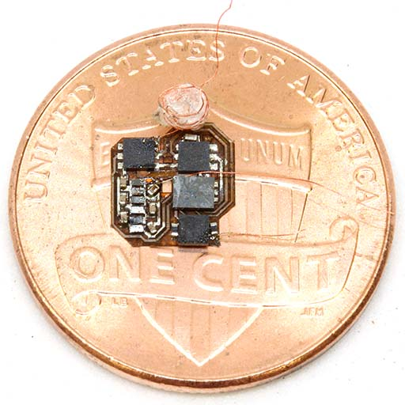
Programmable general purpose design
Programmable microcontroller
Interfaces with temperature and humidity sensors
Low range backscatter communication
Weighs < 30 mg

Slide 40
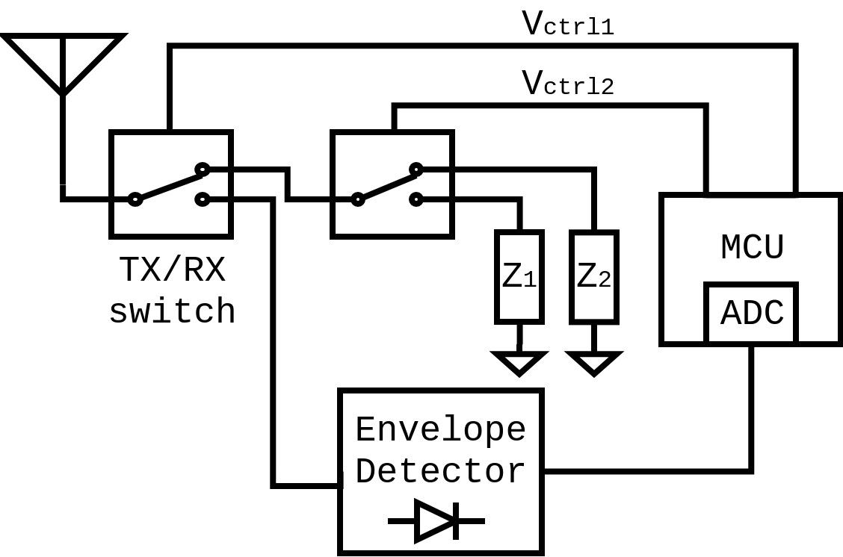
Programmable general-purpose design
Backscatter TX
Receiver

Slide 41
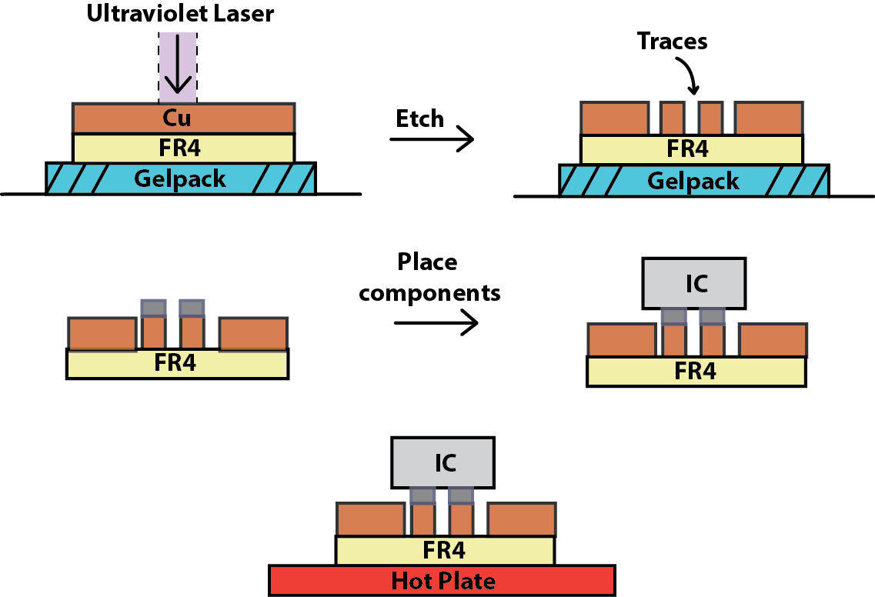
How do we fabricate it?
Step 1: Etch traces with laser
Step 2: Apply solder and place
components
Step 3: Solder components on hot plate

Slide 42
Our Solutions
Building lightweight hardware
2D location tracking of bees

Slide 43
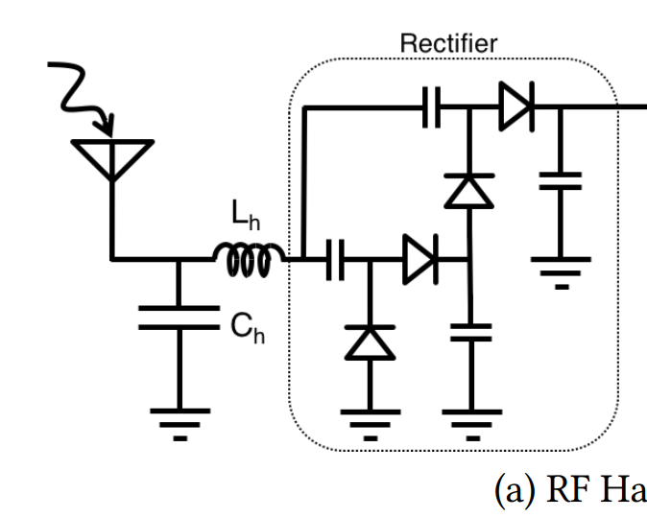


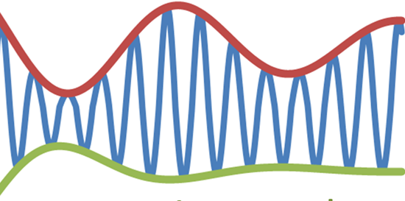
Self localization
Problem: GPS is power expensive
Solution: Passive receiver circuit
GPS

Slide 44
How can we get phase and compute 2D location with just amplitude?

Slide 45
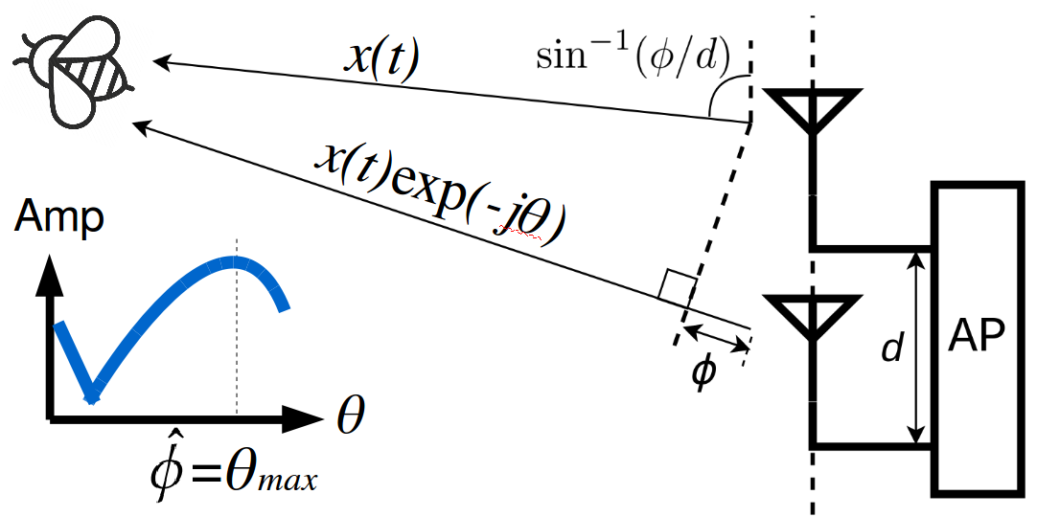
Extracting phase from amplitude
Addressing multipath:
On a farm line of sight path is strongest
Use multiple frequencies to reduce error

Slide 46
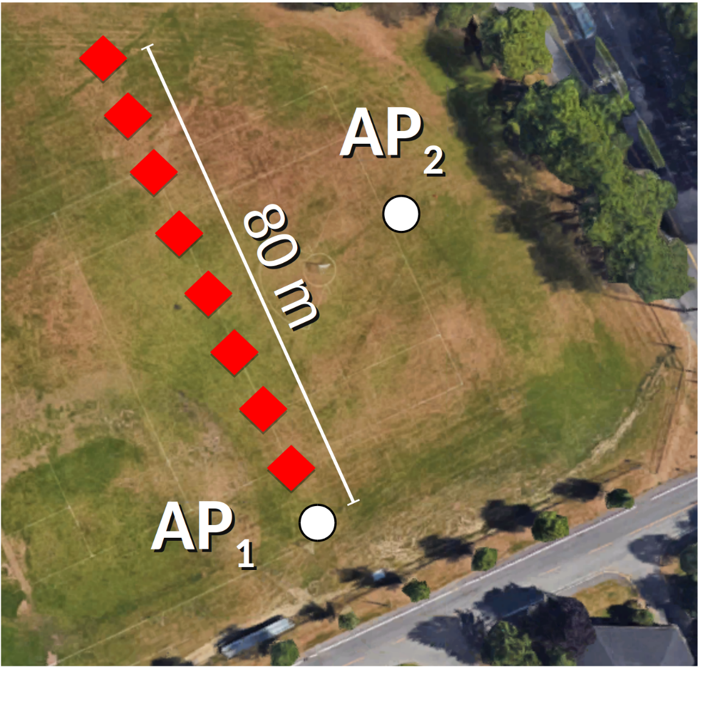
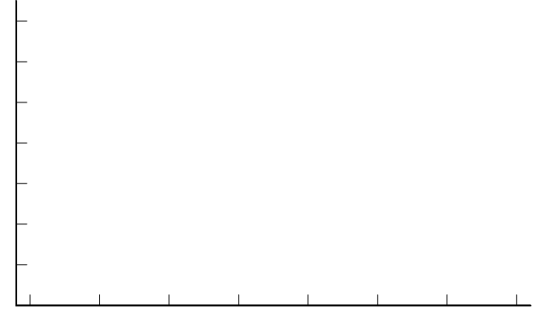
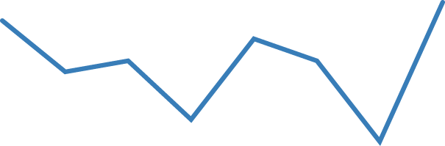
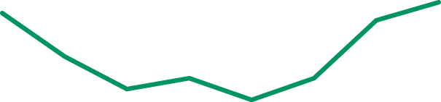

Evaluating localization accuracy
2.25 m/s
3.3 m/s
9.1 m/s
14
12
10
8
6
4
2
0
Angular error (deg)
10 20 30 40 50 60 70 80
Range (m)

Slide 47
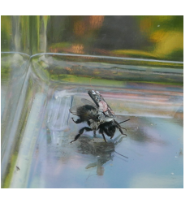
Evaluation
System benchmarks
Stores up to 8000 location and humidity sensor data pairs
Battery life of 7 hrs sampling every 4 s
Harvester can recharge battery in a hive in 6 hrs

Slide 48
Contributions
Insects can be used to carry general purpose sensors
Novel low power self-localization technique
Light-weight programmable platform for computing, communication and sensing

Slide 49
What’s next?
What other sensors can we use?
Can we stream sensor data in real time?
Can we use live insects to build bio-hybrid robots?
Can we use these technologies to better study insects?

Slide 50

livingiot.cs.washington.edu

Slide 51






(3) Robust Ear-based BioSignal Sensing [IEEE TMC’21, ACM MobiSys’20, ACM MobiSys’19 Demo]
Nhat (Nick) Pham‡, Tuan Dinh§, Zohreh Raghebi††, Taeho Kim†, Nam Bui†, Phuc Nguyen†★, Hoang Truong†, Farnoush Banaei-Kashani††, Ann Halbower‡‡, Thang Dinh§§, and Tam Vu†‡
‡University of Oxford, †University of Colorado Boulder, §University of Wisconsin Madison, ††University of Colorado Denver, ★University of Texas at Arlington, ‡‡Children’s Hospital Colorado, §§Virginia Commonwealth University
Notes:
First of one, let’s talk about robust sensing for earables. These works are the results of collaborations among several universities in both the US and the UK.

Slide 52

Electricity inside the brain?
Notes:
First of one, let’s talk about robust sensing for earables. These works are the results of collaborations among several universities in both the US and the UK.

Slide 53
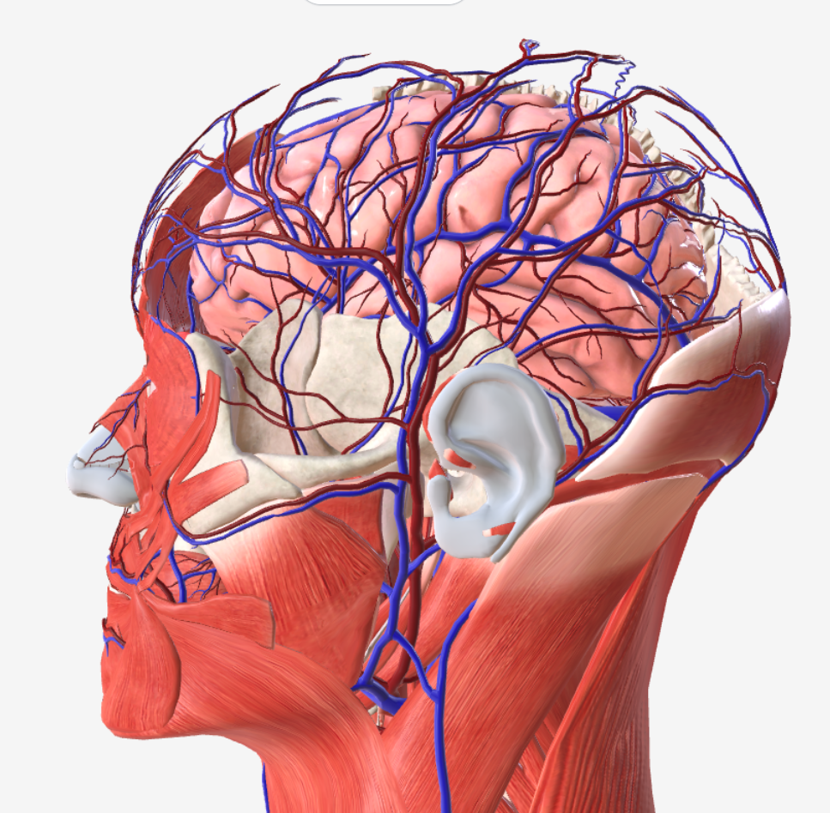
Head-based biosignals
Brain (EEG)
Eyes (EOG)
Facial muscles
(EMG)
Sweat glands
(EDA)
Blood vessels
(PPG)
Notes:
In the past, I have mostly focused on the area inside and around the ear to capture various biosignals on the human head such as …

Slide 54

Current devices are cumbersome!
Notes:
In the past, I have mostly focused on the area inside and around the ear to capture various biosignals on the human head such as …

Slide 55


Our proposed Behind-the-ear wearable system
Able to capture various head-based biosignals
Compact, low cost, can be used daily
Socially acceptable
Notes:
In this work, we propose a Behind-the-ear wearable system, called WAKE, which is able to capture key biomarkers of microsleep. It is also low cost, can be used daily, and socially acceptable.
The behind-the-ear form factor is motivated by the fact that bone-conductance headphones, which are worn behind the ears, are becoming widely used. This technology trend gives us an opportunity to enable a wide range of cognitive monitoring and improvement applications.

Slide 56






Sensing challenges
Heavy noise and motions
Socially acceptable w/ minimal number of sensors
Overlap biosignals with significant (1000x) amplitude range
Unexplored sensing locations
Notes:
The behind-the-ear biosensing system is one of my main research in this direction. To realise it, we face several challenges:
Heavy noises and motion interference in daily uses is the long-standing challenge limiting the practical uses of biosignals sensing systems as it is difficult to ensure high fidelity signals.
Making a wearable, and unobtrusive device that can continuously monitor wakefulness is non-trivial because multiple sensors are usually needed to capture the core biomarkers of wakefulness;
Quantifying microsleep from behind the ears is an unexplored topic where existing techniques cannot be applied directly.
The Behind-the-ears physiological signals are weak and overlap with each other with three order magnitudes range.

Slide 57





Challenge #1: Where to place the sensors? (1/2)
So that:
Wearability and sensing sensitivity can be achieved.
Minimal number of sensors is desirable.
Theta
Alpha
Signal
EOG
EDA
EDA
Ref.
The ear is the intersection of head-based biosignal!
EMG
Notes:
The first challenge that we will need to tackle is to identify the locations of our sensors so that:
Wearability and sensing sensitivity can be achieved, and minimal number of sensors is also desirable.
Our key observation is that the ear is the intersection of multiple microsleep biomarkers such as: theta activities in the mid-brain, alpha waves from the occipital, EOG from the movements of the eyes, EMG from muscles group linked to the chin, and EDA from sweat glands on the back of the ear. Besides, it is also a natural harbor point where a wearable device can be worn.
If we take closer look at the temporal bone which cover the whole behind-the-ear area, we can see it has two major parts: the squamous and the mastoid. The squamous is the thin upper bone. We would want to place a biosensing electrode there so that it can be close to the brain. The mastoid is the thick lower one, where we can place the reference to maximize the voltage potential for EEG/EOG/EMG. EDA can be captured by captured by placing electrodes on the area with high sweat gland density on the back of the ear.
With this, we can reduce the need of multiple sensors on the head and face into a small set sensors behind the ear to achieve wearability. But how about sensing sensitivity?

Slide 58




Challenge #1: Where to place the sensors? (2/2) Feasibility confirmation
Unique characteristics/challenges of the BTE signals?
Low amplitude of BTE EEG/EOG. (i.e. <50uV vs. 100-500uV)
Overlap frequency bands between BTE EEG/EOG and EMG with a significant amplitude difference (i.e. 1000x).
Notes:
To confirm this, we conducted a set of experiments by placing the sensors behind the ears.
Furthermore, there is a question that we need to ask, what are the unique characteristics of BTE signals? So we can take them into account while realizing WAKE.
In the first experiment, we can see that both channels can capture alpha activities when the subject closes their eyes. In the second experiment, we can see that eye blinks can be captured by the first ear channel while eye movements are captured by the second one. EMG from facial muscle contractions can be easily captured by both channels. Finally, EDA can also be seen from behind the ear during exciting periods.
From the data, we can notice that our BTE EEG and EOG has a fairly low amplitude than ones from standard placements. This is probably because of the further distance from the signal sources. Additionally, there is an overlap between BTE EEG/EOG and EMG signals with a significant amplitude difference. This is a challenge that we will need to address to ensure high-fidelity signals.

Slide 59


Challenge #2: Motion and environmental noise (1/3)
Motion artifacts:
Micro-motions of the sensing electrodes.
Fluctuation (i.e. microphonic triboelectric effect) of the signal wires.
Environmental noise:
Noise coupled through the human body and signal wires.
Noise characteristic varies across environments.
Motion and environmental noise is a long-standing challenge!
Notes:
One of the most important challenges of designing a reliable wearable device is to cancel the noises created by human motions and coupled from the environment. From our in-lab experiments, we can observe that environmental noise has a significant impact on the captured signals while motion can completely distort the signal.
According the literature, there are two main sources of motion artifacts: (1) micro-movements of the sensing electrodes and (2) microphonic triboelectric effect on the signal wires. They lead to the fluctuations in electrical pathway resulting in noises.
Radio and electromagnetic inference from various appliances can easily coupled into human body and signal wires which act as antennas. To make it more challenging, depend on the environment, the noise could vary. Thus, the solution also need to work across different environments.

Slide 60







Challenge #2: Motion and environmental noise (2/3)
Three-folds cascaded amplifying (3CA) – Motion artifacts
Electrical model:
$$V_{o}=G∗V_{s}= \frac{A∗V_{s}}{1+\left(Z_{c1}+Z_{c2}\right)(\frac{1}{R_{i}}+jw(C_{w}+C_{i}+\left(A−1\right)C_{p})}(∗)$$
Movement of the wires => changes in $C_{w}$
Micro-motion of the electrode => changes in $Z_{c1},{ Z}_{c2}$
=> Fluctuations of the output signal.
Introduce Stage 1 - Unity-gain amplifying:
Z transformation: transform $Z_{c1},{ Z}_{c2}$ in (*) to $Z_{o1},{ Z}_{o2}$ (~0) => eliminate the effect of $C_{w}$.
$$V_{o}= \frac{A_{1}∗V_{s}}{1+Z_{c1}(\frac{1}{R_{i1}}+jw(C_{w1}+C_{i1}+\left(A−1\right)C_{p1})}=\frac{A_{1}∗V_{s}}{1+Z_{c1}γ}$$
Minimizing effect of $Z_{c1}$ changes: Minimize $γ$ by using A=1, maximizing $R_{i1}$, minimizing $C_{i1}$, $C_{w1}$.
Notes:
We propose a technique called three-folds cascaded amplifying (or 3CA) to mitigate motion artifacts and environmental noises in real-time at the electrical level. In a conventional biosensing system, we can model the relationship among the output signal, the contact impedance, inherent capacitance of the signal wires, and input impedance of the amplifier through this equation.
The triboelectric effect due to movement of the wires will create changes in the inherent capacitance. On the other hand, micro-motion of the electrodes create changes in the contact impedance.
To address these fluctuations, we introduce stage 1 - Unity-gain amplifying. By doing Z transformation in this stage, we can effectively eliminate the effect of the inherent capacitance.
Rewrite the 1st equation for the first stage, we will have the 2nd equation:
The changes in contact impedance can be mitigated when gamma value in the second equation is minimized by using a unity gain buffer, maximizing input impedance, and placing the amplifier as close to the electrode as possible.

Slide 61



Challenge #2: Motion and environmental noise (3/3)
Three-folds cascaded amplifying (3CA) – Environmental noise
Introduce Stage 2 - Feed Forward Differential PreAmplifying (F2DP):
2 separate amplifying stages minimize the effect of motion due to contact impedance.
Feed-Forward Differential Amplifying technique with dual instrumentation amplifiers:
Enhance Common-mode rejection ratio (CMRR).
$${CMRR}_{IA}= \frac{G_{DM}}{G_{CM}};$$
$${CMRR}_{F2DP}= \frac{G_{DM1}+G_{DM2}}{|G_{CM1}−G_{CM2}|}$$
Produce amplified, fully differential signals => robust again environmental noises.
Balanced AC-coupling topology: efficiently remove DC component while mitigating component mismatches issue.
Notes:
To address the noise coupling from the environment, we will need to add another stage called Feed Forward Differential PreAmplifying (F2DP) to amplify our BTE signals before driving the signal wires.
Feed-Forward Differential Amplifying technique is employed in our design so that we can enhance the CMRR, which is the ability to reject noise coupled to the human body. Furthermore, it also produces amplified and fully differential output signals which are robust against environment noises coupled into the signal wires.
For F2DP to work, we need to remove the DC component inside the input signals. The conventional RC high-pass filter suffers from component mismatches which compromise the CMRR. So we used a balanced AC-coupling topology to effectively remove DC component without suffering from component mismatches.

Slide 62

Challenge #3: Overlap signal with a significant range (1/2)
Using a fixed gain is not efficient!
High gain => saturate BTE EMG signal.
Low gain => increase noise floor for weak BTE EEG/EOG signals.
=> The amplifier gain needs to be changed on-the-fly.
VS.
Observations on BTE signal patterns:
Strong EMG events don’t happen frequently.
EMG events can happen abruptly.
EMG signal is stochastic and can vary significantly.
BTE EEG/EOG is overlap with EMG in a three-orders magnitude range!
Notes:
One of the challenge that we noticed with our BTE signal is the overlap between EEG/EOG and EMG signals in three orders magnitude range.
As a result, using a fixed gain is not efficient. Using a high gain to have a better resolution for EEG and EOG could saturate EMG signals. On the other hand, using a low gain to avoid EMG saturation will increase the noise floor for EEG and EOG signals. To handle this issue efficiently, the gain of our amplifier needs to be changed on-the-fly.
To do so, we made several observations on the patterns of our BTE signals: first, strong EMG events don’t happen frequently. However, they can suddenly happen with a significant magnitude. Besides, EMG signal is stochastic, and it can vary significantly.

Slide 63


Challenge #3: Overlap signal with a significant range (2/2)
Adaptive Amplifying and Adaptive Gain Control
Introduce Stage 3 – Adaptive Amplifying with an Adaptive Gain Control algorithm:
Initially, keep the gain at maximum for BTE EEG/EOG signal.
React quickly to abrupt increases from the initial state => capture an EMG event quickly.
React slowly to abrupt decreases while an EMG event is happening => avoid gain oscillation.
Square Law Detector vs. Peak Envelope Detector:
Both can be used for AGC.
PED with dynamic windows is used because of low complexity.
Notes:
We introduce our stage 3 of 3CA, adaptive amplifying. We employ a programmable instrumentation amplifier and include an Adaptive Gain Control algorithm in our firmware to control it.
Based on our observations of the BTE signals, we devise our algorithm with 3 steps. Initially, the it keeps the gain a maximum so that our BTE EEG/EOG signal can be captured with a low noise floor. Then, it needs to react quickly to sudden increases from the initial state so that we can capture an EMG event quickly. While an EMG event is happening, it needs to react slowly to sudden decreases to avoid gain oscillation due to the variations of EMG signals.
We find out that both square law detector and peak envelope detector with dynamic windows can achieve this property. However, we decided to employ PED because of its low complexity to be implemented on the firmware.

Slide 64




Implementation
System Overview
Earpieces design
Sensing device
Notes:
This figure presents an overview of our system. Our hardware consist of a pair of silicon earpieces attached with biosignal sensors and 3CA circuits. On the firmware, we have the adaptive gain control algorithm and processing functions to digitalize sensor signals and stream them to our software on a host device. The sensor data is then be processed and decomposed into separated components. They are feed to our machine learning model to classify microsleep events.
The following figures show the design of our BTE silicone earpieces. We choose silicone so it can be comfortable to wear and deform with different ear shapes. We embed a memory wire inside the earpiece to keep our sensing electrodes contacted with the skin.
The last figure shows our custom-built sensing hardware, which has a low power MCU, an analog front end, and a Bluetooth module to provide the wireless connection.

Slide 65


Evaluation #1 – Signal Sensitivity Validation
BTE vs. Ground-truth signals
Normalized Cross Correlation
Electrode placements
 | Ear1 | Ear2
C3-M2 | 0.35 (moderate)
C4-M1 |  | 0.44 (moderate)
O1-M2 | 0.28 (weak)
O2-M1 |  | 0.52 (moderate)
VEOG | 0.47 (moderate)
HEOG |  | 0.59 (strong)
Chin EMG | 0.62 (strong) | 0.76 (strong)
Left Wrist EDA | 0.37 (moderate)
Notes:
We conducted 4 sets of experiment to evaluate our WAKE prototype. In the first evaluation, we compare the signals captured from behind the ear with ground-truth ones. They ground-truth signals are captured by medical-grade devices with standard placements. The experiment was about 40 minutes long.
The captured signals are shown in the following figures. We can see that our BTE signals have similar shapes and patterns similar to the ground-truth ones. However, the BTE EEG and EOG signals are much smaller.
To quantitively compare them, we calculate the normalized cross correlation values. The results show that our BTE signal has moderate to strong correlation with the ground-truth ones and contain enough biomarkers for microsleep detection.

Slide 66






Evaluation #2 – Motion and Environmental Noise Suppression
Motion artifact evaluations:
Standing vs. Walking.
Parking (w/ a running engine) vs. Driving.
Durations: 40-60 minutes
Environmental noise evaluations:
3 different environments: Office, Residential area, and Inside a car.
Durations: 60 minutes
Office
Residential Area
Inside a Car
Notes:
In the second experiment, we evaluated the ability to withstand noisy conditions in the real-world.
In our motion evaluations, we compare the captured signals with and without our 3CA technique during walking and driving. While standing, we can capture eye blinks clearly with and without 3CA. However, during walking, the signal is completely distorted by motion without 3CA. We can observe a similar result during the driving scenario. 3CA can reduce 11-19 dB of the noise power introduced by motion.
In our environmental noise evaluation, we also compare the captured signals in 3 different environments: in an office, in a residential area, and inside a car. The results shown that electromagnetic inference are minimized with 3CA by 9-16 dB. When the subject is sitting a car, most of the environmental noise is actually coming from the motion of the car.

Slide 67

Evaluation #3 – Microsleep Detection Performance
Classification model:
35,558 awake and 8,845 microsleep data points.
Epoch size: 5s, 80% overlap (i.e. slide every 1s).
Durations: maximum 2 hours/each subject.
Hybrid model of a hierarchical classifier (Random Forest, Adaboost, SVM) and EMG-event-based heuristic rule.
Experiment Setup
Classification Performance
Demographic:
19 subjects.
Healthy: 9, Sleep deprivation: 9, Narcolepsy: 1.
Experiment duration: maximum 2h.
Ground-truth: Video-PSG system with 2 sleep experts.
Experiment | Precision | Sensitivity | Specificity
Leave-one-subject-out (Inter-subject) | 0.76 | 0.85 | 0.85
Test-set (75%/25%) (Intra-subject) | 0.87 | 0.9 | 0.96
Leave-one-sample-out (Intra-subject) | 0.88 | 0.89 | 0.96
Notes:
In the third experiment, we evaluate the ability to detect microsleep with WAKE by conducting the Maintance of Wakefulness Test on 19 subjects. The Video PSG system and the scoring from 2 sleep experts were used as the ground truth.
Our dataset has more than 40000 data points. We developed a hybrid classification model to classify awake and microsleep epoch.
In the leave-one-subject-out validation, our model can achieve the 76% for precision and 85% for both sensitivity and specificity on an unseen subject. On a specific subject, we can achieve more than 87% for all the metrics

Slide 68
Key takeaways
To get good application results, the input data/signal needs to be clean. We should not depend on machine learning to do all the work.
Software solutions might not always able to reliably solve the challenges in Cyber-Physical systems
Low-level hardware solutions are sometimes needed to solve the root cause.
Data collections on human can take time (and can be quite messy).
Notes:
In this work, we have made the following contributions:
First, we devise a 3CA technique to mitigate motion and environmental noises
Second, we identify a minimal of number of areas behind human ears so that a wearable, compact, and socially acceptable device can be designed.
Third, a hybrid classification model is developed to classify microsleep at second level resolution.
Finally, we evaluated our proposed system on 19 subjects to show the feasibility of WAKE.
There are still rooms for improvements in the future work such as conducting an microsleep detection evaluation in the real world, optimizing the WAKE device and exploring different effects of human artifacts.

Slide 69


(4) Efficient computing on wearables (ACM MobiCom’22)
Nhat (Nick) Pham¹, Hong Jia², Minh Tran¹, Tuan Dinh³, Nam Bui⁴, Young Kwon², Dong Ma⁵, Phuc Nguyen⁶, Cecilia Mascolo², and Tam Vu⁴
¹University of Oxford, ²University of Cambridge, ³University of Wisconsin Madison, ⁴University of Colorado Boulder, ⁵CSingapore Management University, ⁶University of Texas at Arlington.
Notes:
In the second part, we will discuss how we could achieve efficient computing for long-term biosensing monitoring applications.

Slide 70


Motivation
What can we enable w/ 40X high-fidelity biosignal compression on wearables?
Prevent fatalities!
Enhance usability!
Notes:
Let us start with a question? What can we enable if we can compress high-fidelity biosignal by, say, 40X on wearables?
I believe we can
(1) prevent fatalities from critical conditions like seizures and (2) enhance usability by removing a big battery bag like this one. Let’s look into how.

Slide 71





The problem
Many healthcare biosignal-based applications are not practical for wearables!
Long-term, high-fidelity monitoring
High data rate
Low-latency response
Small battery, resource-constrained devices
Weeks/Days not hours!
Communication is energy heavy!
Slow responses could be fatal!
MHz CPU, KB Memory!
Notes:
The issue that we are seeing now is many healthcare biosignal-based are not very practical for earables because of several reasons.
Those applications depend on long-term and high-fidelity biosignal monitoring.
That will result in a very high data transmission rate, which is energy heavy for low-power wireless communication protocols.
Some applications also require low-latency responses from the device. Like a seizure can be fatal if we can not warn the caregiver in time.
Last but not least, all of these requirements are placed on energy and resource-constrained wearables. Most of them have small batteries, MHz MCU, KB Memory.

Slide 72


The conventional trade-off
Signal Quality
VS.
Battery Life
Medical Biosignal Monitoring
Brain/Eyes/Muscle: 10-20x1024Hz.
Battery life: >24h, w/ a big bag of batteries
Need constant monitoring by technicians.
Embrace2 Wearable
Battery life: 48h
Sweat: 4Hz (vs 512Hz in diagnostic)
Motion: 3x32Hz, Temp.: 1Hz.
Real-time alerts through a mobile app.
A new solution is needed to overcome this trade-off!
Notes:
So the conventional trade-off that we have to do now is to reduce signal quality to improve the battery life.
On the left hand side, we have a medical-graded biosignal monitoring, it will provide high quality biosignal but the user need to wear a big bag of batteries.
On the other hand, the right side is a Embrace Wearable device from MIT, which achieves up to 48h but at the cost of much lower biosignal quality.

Slide 73

Our proposed Pattern-dRiven cOmpressive Sensing (PROS) system
Long battery life
High fidelity biosignals
Low-latency responses
Computational efficiency
Notes:
To overcome that trade off, we introduce a pattern-driven compressive sensing framework. We aim to achieve long battery life, high-fidelity biosignal, low-latency responses, and computational efficiency at the same time.

Slide 74


Observations
#1: Biosignal events are sparse!
#2: Biosignals are (potentially) sparse!
<5%
Exploiting event and signal sparsity -> significant streaming data reduction
#3: However, developed algorithms need to be efficient!
Notes:
To make it work, our design is based on two observations
Biosignal events are sparse. Events such as seizure or microsleep are only happen <5% of the time.
Furthermore, the biosignal itself is potential sparse.
Thus, if we can exploit both event and signal sparsity properties, it could result in significant streaming data reduction, leading to much longer battery life
However, there is one tiny catch, that our developed algorithms need to be efficient since we will need to deploy them on resource-constrained devices.

Slide 75






Challenge #1: How to detect biosignal events efficiently on wearables? (1/2)
Detection of biosignal events on wearables is challenging!
Multiple signal modalities (e.g., EEG, EOG, EMG, etc.)
Constrained hardware and energy resources.
Complex biosignal events can be broken down into patterns of interest (PoIs)!
Notes:
The first question is how to detect biosignal events on wearable devices?
It turns out this is very challenging because (1) multiple signal modalities and (2) the computational resource on wearables are very constrained, so complex algorithms such as deep learning algorithms are not easy to deployed while maintaining the accuracy.
However, there is one thing that we notice that complex biosignal events can be broken down into patterns of interest.
For examples, seizure events can be decompose into several patterns such as spike and wave, polyspike or jerking patterns.
Similarly, we can do the same thing for microsleep events.

Slide 76


Challenge #1: How to detect biosignal PoIs efficiently on wearables? (2/2)
Tiny Pattern Recognition models (TinyPRs)
Each TinyPR detects one pattern.
Fine-tuned feature extraction (MFCC).
Flexible Depth-wise and Point-wise Convolution layers.
Accelerated by SIMD and DSP.
Controllable
How can we push the data transmission reduction further?
Pattern probability
Notes:
To detect those patterns, we develop tiny pattern recognition models
Each model only detect one pattern to ensure efficiency and reusability
We also fine-tuned feature extraction to extract informative features such MFCC so that we don’t need to depend on autoencoders.
We also provide the flexible depth-wise and point-wise convolution layers so we can tune the accuracy and computational resource of the models.
Now, we can detect the biosignal, the next question is how can we push the data reduction further?

Slide 77


Challenge #2:How to compress the detected PoIs? (1/2)
Biosignals are potentially sparse in time-frequency domains (wavelets, Gabor, etc.), but…
Large variations among channels and trails. -> sub-optimal compression!
A universal optimal sparse domain might not exist.
Optimal domains for
individual biosignal patterns!
Optimal Wavelet Search Algorithm
Notes:
Let’s see how can compress the captured biosignals on wearables,
We know that biosignals are potentially sparse in time-frequency domains however, …
Our hypothesis is that a universal optimal sparse domain for biosignal might not exist. However, we probably could find optimal domains for individual patterns so we introduce an optimal wavelet search algorithm to do so. The details could be found in the paper.

Slide 78

Challenge #2:How to compress the detected PoIs? (2/2)
Pattern-driven Compressive Sensing (CS)
Wearable device:
Pattern probability from TinyPRs.
Dynamic Random Binary Matrices compressing based on the detected patterns.
Processing efficiency?
Mobile device:
Biosignal reconstruction based on Block Sparse Bayesian Learning.
Dynamic wavelet domains selection on the fly.
Notes:
This is the schematic for our proposed pattern-driven compressive sensing technique
On the WEarable device,
After getting the pattern probability from TinyPR models, we apply dynamic random binary matrix compression based on the detected pattern.
Then on the Mobile, we use the Block Sparse Bayesian learning method together with the dynamic wavelet domain selection to reconstruct the orginal signal.
At this point, we can significantly reduce data transmission, but data transmission might not be the main bottleneck anymore.
Since we added more computations to the devices, how can we optimize the processing efficiency?

Slide 79



Challenge #3: How to optimise processing efficiency? (1/1)
Dynamic Frequency and Voltage Scaling (DVFS)
Choose the optimal CPU efficiency point based on application’s requirements.
↑ CPU Frequency -> ↑ Sleep time -> ↑ Voltage
Adaptive Energy Detector
Some background signals are too obvious for TinyPRs!
Tickless Kernel Mode
Eliminate periodic CPU wake-ups!
Ultra-low power interrupt-based timebase.
Notes:
There are several techniques to enhance the processing
Dynamic f and v scaling
Adaptive Energy Detector
Tickless Kernel Sleep

Slide 80


Implementation
Wearable
Low-power ARM MCU, 120 MHz, 1MB FLASH, 256KB RAM,
TinyPR pipeline,
Pattern-driven Compressive Sensing,
Hardware and low-level optimisations.
System Overview
Mobile
Surface Go, Galaxy S20,
Reconstruction algorithm.
Optimised biosensing hardware
Notes:
This is the overview of our system implementation.
On the wearable device, we have a customized hardware with a low-power ARM MCU.
On its firmware, we have the pipeline for TinyPR, the PDCS algorithms and low-level optimizations that we discussed before.
On the mobile side, we deploy our signal reconstruction algorithm on two different devices.

Slide 81

Evaluation #1 – Tiny Pattern Recognition Performance
TinyPR’s performance:
2 open datasets (hospital settings).
6 biosignal patterns.
120 subjects (100 train/20 test), 2,099,479 data points.
75% - 96% Sensitivity and Specificity on unseen subjects.
Notes:
In the first evaluation, we evaluate our TinyPR models on two open datasets with 6 biosignal patterns and 120 subjects, 100 for training and 20 for testing.
The results show we can achieve 75-96% sensitivity and specificity on unseen subjects.

Slide 82


Evaluation #2 – Pattern-Driven Compressive Sensing Performance
Optimal wavelet search
71% - 93% sparsity for each biosignal pattern.
CS performance:
Up to 5X compression (CS alone)
Up to 40X compression (CS + TinyPR)
Notes:
In the second evaluation, we evaluate our proposed pattern-driven compressive sensing technique.
The optimal wavelet search could identify the optimal wavelet domain for each pattern with up to 93% sparsity.
With the CS alone, we can reach up to 5X compression factor and when we combine CS and TinyPR, we could reach up to 40X.

Slide 83


Evaluation #3 – Hardware runtime performance
Hardware performance
TinyPR: 5KB FLASH, 30 KB RAM, 26ms (@120MHz).
CS: 4-30KB FLASH, 1ms (Wearable), 50-94ms (Mobile devices)
Epileptic Seizure Monitoring use case:
10 unseen subjects: 277,662 data points.
3 patterns: Focal, Absence, Tonic-Clonic.
High-fidelity: 85% Sensitivity, 0.92 SSIM.
Transmission reduction: 24X.
Energy improvement: >1200%.
500mAh -> last the whole week.
Able to detect fatal tonic-clonic seizures < 32ms.
Notes:
We deploy the algorithms on our hardware and several open-source platforms such as Arduino and Rasp Pi.
The results show that both our TinyPR and CS algorithm only require KBs of Memory and can run in several ms on low-power MCUs.
Finally, we put together a practical epileptic seizure monitoring use case with 10 unseen subjects and 3 patterns.
In this use case, we can see that our system can reduce data transmission by 24X and boost energy efficiency by more than 1200%.
It means that with a small battery, our wearable device could last for a whole week while constantly monitoring seizure events.

Slide 84
Key takeaways
On-chip intelligence could enable new optimizations on low-power devices.
The performance of embedded models is always be constrained by energy.
Pre-processing techniques are important to help increasing accuracy, especially in the low-power domain.
Notes:
In this work, we have made the following contributions:
First, we devise a 3CA technique to mitigate motion and environmental noises
Second, we identify a minimal of number of areas behind human ears so that a wearable, compact, and socially acceptable device can be designed.
Third, a hybrid classification model is developed to classify microsleep at second level resolution.
Finally, we evaluated our proposed system on 19 subjects to show the feasibility of WAKE.
There are still rooms for improvements in the future work such as conducting an microsleep detection evaluation in the real world, optimizing the WAKE device and exploring different effects of human artifacts.

Slide 85

Invisible bio-sensing
Notes:
In this work, we have made the following contributions:
First, we devise a 3CA technique to mitigate motion and environmental noises
Second, we identify a minimal of number of areas behind human ears so that a wearable, compact, and socially acceptable device can be designed.
Third, a hybrid classification model is developed to classify microsleep at second level resolution.
Finally, we evaluated our proposed system on 19 subjects to show the feasibility of WAKE.
There are still rooms for improvements in the future work such as conducting an microsleep detection evaluation in the real world, optimizing the WAKE device and exploring different effects of human artifacts.

